Slide 1
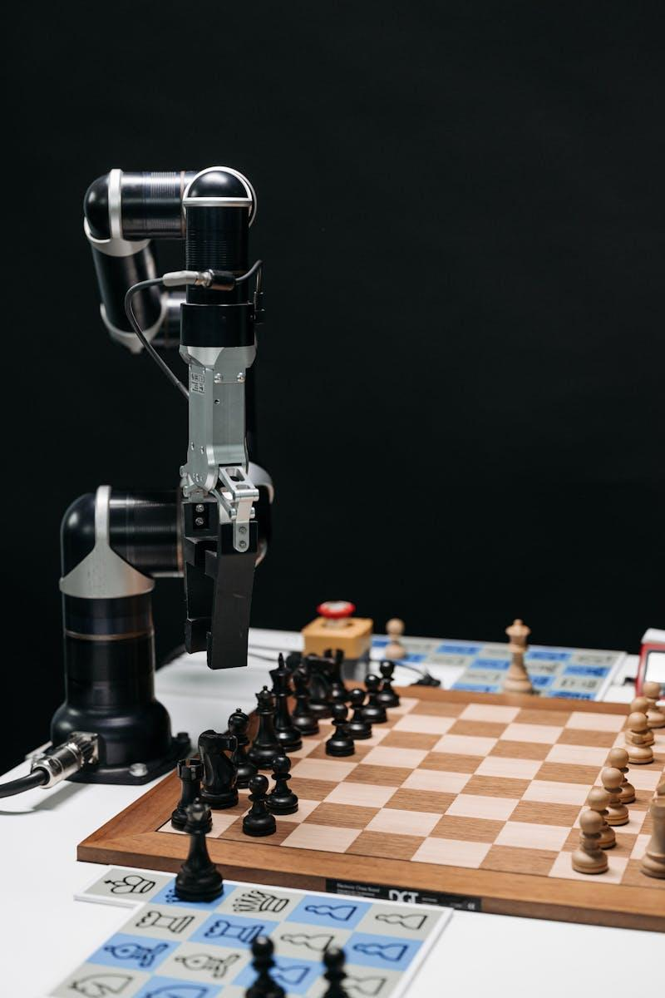
AI Technical Interviewer: Project Overview
Next-Gen Solution for Technical Interviews
Photo by Pexels

Slide 2
Table of Contents
01
Project Overview
02
Dynamic Questioning
03
Content Moderation
04
Professional UI
05
Secure Data Handling
06
Real-Time Feedback
07
Customizable Interview Flow
08
Challenges & Solutions
09
Future Scope

Slide 3

1
Project Overview
Introduction
The AI Technical Interviewer revolutionizes initial technical interviews, powered by GPT-4o and Python, offering an interactive and adaptive experience tailored to candidates.
Features dynamic questioning, experience-based adjustment, content moderation, professional UI, secure data handling, real-time feedback, and customizable interview flow.
Tech Stack: Language - Python, Frameworks/Libraries - Gradio, OpenAI API, CSS. Features dynamic interaction, content moderation, and conversation context tracking.
Challenges: Context Management, Difficulty Scaling, Security, Edge Case Detection. Solutions include robust message history, experience-based question tiers, secure data handling, and response validation system.
Photo by Pexels

Slide 4

2
Dynamic Questioning
Skill-Specific Questions
Automatically generates skill-specific technical questions based on the declared technology stack.
Ensures relevance and depth in questioning, enhancing the assessment process for candidates and interviewers.
Utilizes advanced algorithms to adjust question difficulty for different experience levels, maintaining an engaging interview atmosphere.
Promotes a comprehensive evaluation of candidates' technical knowledge and problem-solving skills, simulating real-world scenarios.
Photo by Pexels

Slide 5

3
Content Moderation
Advanced Filtering
Ensures safe and professional interactions by filtering content and preventing inappropriate language or behavior.
Maintains a positive and respectful interview environment, enhancing the candidate's experience and perception of the hiring process.
Utilizes AI-powered moderation tools to analyze and flag potentially harmful or inappropriate content, prioritizing user safety and comfort.
Guarding against any potential misuse or misconduct, creating a secure and trustworthy interview setting for all participants.
Photo by Pexels

Slide 6

4
Professional UI
Gradio Interface
Powered by Gradio with a sleek and responsive design, offering a user-friendly and visually appealing interview experience.
Enhances the overall interaction and usability, providing intuitive navigation and a modern interface for both candidates and interviewers.
Optimizes the interview process with easy access to features, clear information display, and seamless navigation for a smooth user experience.
Reflects professionalism and sophistication, setting a positive first impression and fostering engagement throughout the interview session.
Photo by Pexels

Slide 7

5
Secure Data Handling
GDPR Compliance
Complies with GDPR regulations and encrypts sensitive information to ensure data privacy and protection throughout the interview process.
Prioritizes the confidentiality and security of candidate data, implementing robust measures to prevent unauthorized access or data breaches.
Maintains transparency and accountability in data handling, instilling trust and confidence in both candidates and organizations using the platform.
Adheres to industry standards and best practices in data security, safeguarding information and upholding ethical principles in data management.
Photo by Pexels

Slide 8

6
Real-Time Feedback
Enhanced Evaluation
Provides instant feedback on candidate responses, enabling real-time assessment and performance evaluation during the interview process.
Facilitates immediate insights into candidate capabilities, strengths, and areas for improvement, enhancing the interview experience and decision-making.
Promotes interactive engagement and learning through immediate feedback, fostering continuous improvement and skill development for candidates.
Enhances communication between candidates and interviewers, creating a dynamic and constructive dialogue to maximize assessment effectiveness.
Photo by Pexels

Slide 9

7
Customizable Interview Flow
Adaptation Flexibility
Allows easy configuration of interview structures to align with specific hiring needs, tailoring the interview experience to match organizational requirements.
Offers customization options for question types, difficulty levels, and flow adaptability, enhancing the flexibility and relevance of the interview process.
Enables personalized interviews tailored to different roles, experience levels, and technical competencies, ensuring a targeted and efficient assessment approach.
Supports dynamic adjustments during the interview, accommodating changing requirements and objectives for comprehensive evaluation and selection.
Photo by Pexels

Slide 10

8
Challenges & Solutions
Innovative Approaches
Challenges: Context Management, Difficulty Scaling, Security, Edge Case Detection. Solutions include message history, experience-based question tiers, secure data handling, and response validation system.
Addresses the complexity of maintaining coherent conversation flow, adjusting question difficulty, handling sensitive data, and detecting edge cases effectively.
Ensures robust solutions for handling challenges in technical interview settings, enhancing user experience and platform reliability.
Promotes innovation and adaptability in overcoming obstacles, providing a seamless and secure interview environment for both candidates and organizations.
Photo by Pexels

Slide 11

9
Future Scope
Expansion Opportunities
Future Scope: Multilingual Support, Integration with ATS, Advanced Analytics. Enable interviews in multiple languages, integrate with ATS, and provide detailed insights on candidate performance.
Expands the platform's capabilities to cater to a diverse global audience, streamline hiring processes, and offer deeper insights for informed decision-making.
Enhances the platform's functionalities with advanced features and integrations, positioning it as a comprehensive and cutting-edge solution for technical interviews.
Drives innovation and growth by exploring new avenues for improvement and development, adapting to evolving needs and technological advancements in recruitment practices.
Photo by Pexels

